Slide 1

9
THE REAL ECONOMY IN THE LONG RUN

Slide 2
25
Production and Growth

Slide 3
Production and Growth
A country’s standard of living depends on its ability to produce goods and services.

Slide 4
Production and Growth
Within a country there are large changes in the standard of living over time.

Slide 5
Production and Growth
In the United States over the past century, average income as measured by real GDP per person has grown by about 2 percent per year.

Slide 6
Production and Growth
Productivity refers to the amount of goods and services produced for each hour of a worker’s time.
A nation’s standard of living is determined by the productivity of its workers.

Slide 7

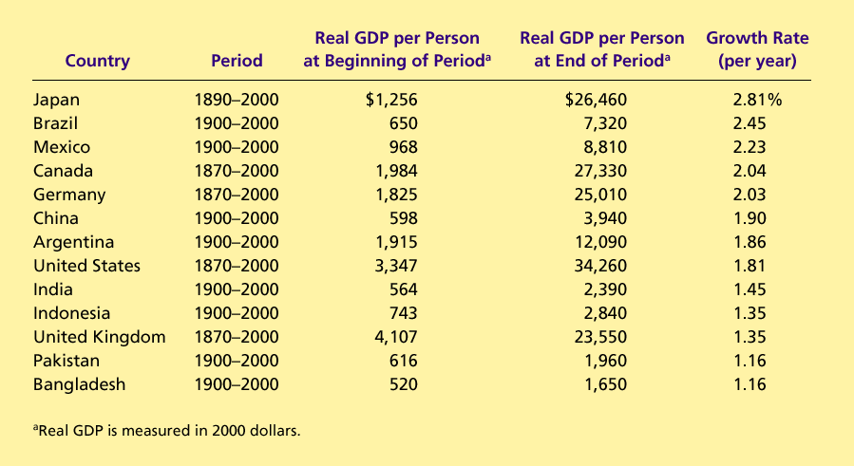
Table 1 The Variety of Growth Experiences
Copyright©2004 South-Western

Slide 8
ECONOMIC GROWTH AROUND THE WORLD
Living standards, as measured by real GDP per person, vary significantly among nations.

Slide 9
ECONOMIC GROWTH AROUND THE WORLD
The poorest countries have average levels of income that have not been seen in the United States for many decades.

Slide 10
ECONOMIC GROWTH AROUND THE WORLD
Annual growth rates that seem small become large when compounded for many years.
Compounding refers to the accumulation of a growth rate over a period of time.

Slide 11
PRODUCTIVITY: ITS ROLE AND DETERMINANTS
Productivity plays a key role in determining living standards for all nations in the world.

Slide 12
Why Productivity Is So Important
Productivity refers to the amount of goods and services that a worker can produce from each hour of work.

Slide 13
Why Productivity Is So Important
To understand the large differences in living standards across countries, we must focus on the production of goods and services.

Slide 14
How Productivity Is Determined
The inputs used to produce goods and services are called the factors of production.
The factors of production directly determine productivity.

Slide 15
How Productivity Is Determined
The Factors of Production
  Physical capital
  Human capital
  Natural resources
  Technological knowledge

Slide 16
How Productivity Is Determined
Physical Capital
  is a produced factor of production.
    It is an input into the production process that in the past was an output from the production process.
  is the stock of equipment and structures that are used to produce goods and services.
    Tools used to build or repair automobiles.
    Tools used to build furniture.
    Office buildings, schools, etc.

Slide 17
How Productivity Is Determined
Human Capital
  the economist’s term for the knowledge and skills that workers acquire through education, training, and experience
    Like physical capital, human capital raises a nation’s ability to produce goods and services.

Slide 18
How Productivity Is Determined
Natural Resources
  inputs used in production that are provided by nature, such as land, rivers, and mineral deposits.
    Renewable resources include trees and forests.
    Nonrenewable resources include petroleum and coal.
  can be important but are not necessary for an economy to be highly productive in producing goods and services.

Slide 19
How Productivity Is Determined
Technological Knowledge
  society’s understanding of the best ways to produce goods and services.
  Human capital refers to the resources expended transmitting this understanding to the labor force.

Slide 20
FYI: The Production Function
Economists often use a production function to describe the relationship between the quantity of inputs used in production and the quantity of output from production.

Slide 21
FYI: The Production Function
Y = A F(L, K, H, N)
  Y = quantity of output
  A = available production technology
  L = quantity of labor
  K = quantity of physical capital
  H = quantity of human capital
  N = quantity of natural resources
  F( ) is a function that shows how the inputs are combined.

Slide 22
FYI: The Production Function
A production function has constant returns to scale if, for any positive number x,
xY = A F(xL, xK, xH, xN)
That is, a doubling of all inputs causes the amount of output to double as well.

Slide 23
FYI: The Production Function
Production functions with constant returns to scale have an interesting implication.
  Setting x = 1/L,
  Y/ L = A F(1, K/ L, H/ L, N/ L)
    Where:
    Y/L = output per worker
    K/L = physical capital per worker
    H/L = human capital per worker
    N/L = natural resources per worker

Slide 24
FYI: The Production Function
The preceding equation says that productivity (Y/L) depends on physical capital per worker (K/L), human capital per worker (H/L), and natural resources per worker (N/L), as well as the state of technology, (A).

Slide 25
ECONOMIC GROWTH AND PUBLIC POLICY
Governments can do many things to raise productivity and living standards.

Slide 26
ECONOMIC GROWTH AND PUBLIC POLICY
Government Policies That Raise Productivity and Living Standards
  Encourage saving and investment.
  Encourage investment from abroad
  Encourage education and training.
  Establish secure property rights and maintain political stability.
  Promote free trade.
  Promote research and development.

Slide 27
The Importance of Saving and Investment
One way to raise future productivity is to invest more current resources in the production of capital.

Slide 28

Figure 1 Growth and Investment
(
a
)
G
r
o
w
t
h
R
a
t
e
1
9
6
0
–
1991
(
b
)
I
n
v
e
s
t
m
e
n
t
1
9
6
0
–
1991
South Korea
South Korea
Singapore
Singapore
Japan
Japan
Israel
Israel
Canada
Canada
Brazil
Brazil
West Germany
West Germany
Mexico
Mexico
United Kingdom
United Kingdom
Nigeria
Nigeria
United States
United States
India
India
Bangladesh
Bangladesh
Chile
Chile
Rwanda
Rwanda
0
1
2
3
4
5
6
7
0
10
20
30
40
Growth Rate (percent)
Investment (percent of GDP)
Copyright©2003 Southwestern/Thomson Learning

Slide 29
Diminishing Returns and the Catch-Up Effect
As the stock of capital rises, the extra output produced from an additional unit of capital falls; this property is called diminishing returns.
Because of diminishing returns, an increase in the saving rate leads to higher growth only for a while.

Slide 30
Diminishing Returns and the Catch-Up Effect
In the long run, the higher saving rate leads to a higher level of productivity and income, but not to higher growth in these areas.

Slide 31
Diminishing Returns and the Catch-Up Effect
The catch-up effect refers to the property whereby countries that start off poor tend to grow more rapidly than countries that start off rich.

Slide 32
Investment from Abroad
Governments can increase capital accumulation and long-term economic growth by encouraging investment from foreign sources.

Slide 33
Investment from Abroad
Investment from abroad takes several forms:
  Foreign Direct Investment
    Capital investment owned and operated by a foreign entity.
  Foreign Portfolio Investment
    Investments financed with foreign money but operated by domestic residents.

Slide 34
Education
For a country’s long-run growth, education is at least as important as investment in physical capital.
  In the United States, each year of schooling raises a person’s wage, on average, by about 10 percent.
  Thus, one way the government can enhance the standard of living is to provide schools and encourage the population to take advantage of them.

Slide 35
Education
An educated person might generate new ideas about how best to produce goods and services, which in turn, might enter society’s pool of knowledge and provide an external benefit to others.

Slide 36
Education
One problem facing some poor countries is the brain drain—the emigration of many of the most highly educated workers to rich countries.

Slide 37
Property Rights and Political Stability
Property rights refer to the ability of people to exercise authority over the resources they own.
  An economy-wide respect for property rights is an important prerequisite for the price system to work.
  It is necessary for investors to feel that their investments are secure.

Slide 38
Free Trade
Trade is, in some ways, a type of technology.
A country that eliminates trade restrictions will experience the same kind of economic growth that would occur after a major technological advance.

Slide 39
Free Trade
Some countries engage in . . .
  . . . inward-orientated trade policies, avoiding interaction with other countries.
  . . . outward-orientated trade policies, encouraging interaction with other countries.

Slide 40
Research and Development
The advance of technological knowledge has led to higher standards of living.
  Most technological advance comes from private research by firms and individual inventors.
  Government can encourage the development of new technologies through research grants, tax breaks, and the patent system.

Slide 41
CASE STUDY: The Productivity Slowdown and Speedup
From 1959 to 1973 productivity grew at a rate of 3.2 percent per year.
From 1973 to 1995 productivity grew by only 1.5 percent per year.
Productivity accelerated again in 1995, growing by 2.6 percent per year on average during the next six years.

Slide 42
CASE STUDY: The Productivity Slowdown and Speedup
The causes of the changes in productivity growth are elusive.
The slowdown cannot be traced to the factors of production that are most easily measured.
Many economists attribute the slowdown and speedup in economic growth to changes in technology and the creation of new ideas.

Slide 43
Figure 2 The Growth in Real GDP Per Person
Growth Rate
(percent
per year)
4.0
3.5
3.0
2.5
2.0
1.5
1.0
0
1
8
7
0
–
1
8
9
0
–
1
9
1
0
–
1
9
3
0
–
1
9
5
0
–
1
9
7
0
–
1
9
9
0
–
1890
1910
1930
1950
1970
1990
2000
Copyright©2003 Southwestern/Thomson Learning

Slide 44
Population Growth
Economists and other social scientists have long debated how population growth affects a society

Slide 45
Population Growth
Population growth interacts with other factors of production:
  Stretching natural resources
  Diluting the capital stock
  Promoting technological progress

Slide 46
Summary
Economic prosperity, as measured by real GDP per person, varies substantially around the world.
The average income of the world’s richest countries is more than ten times that in the world’s poorest countries.
The standard of living in an economy depends on the economy’s ability to produce goods and services.

Slide 47
Summary
Productivity depends on the amounts of physical capital, human capital, natural resources, and technological knowledge available to workers.
Government policies can influence the economy’s growth rate in many different ways.

Slide 48
Summary
The accumulation of capital is subject to diminishing returns.
Because of diminishing returns, higher saving leads to a higher growth for a period of time, but growth will eventually slow down.
Also because of diminishing returns, the return to capital is especially high in poor countries.

